Slide 1
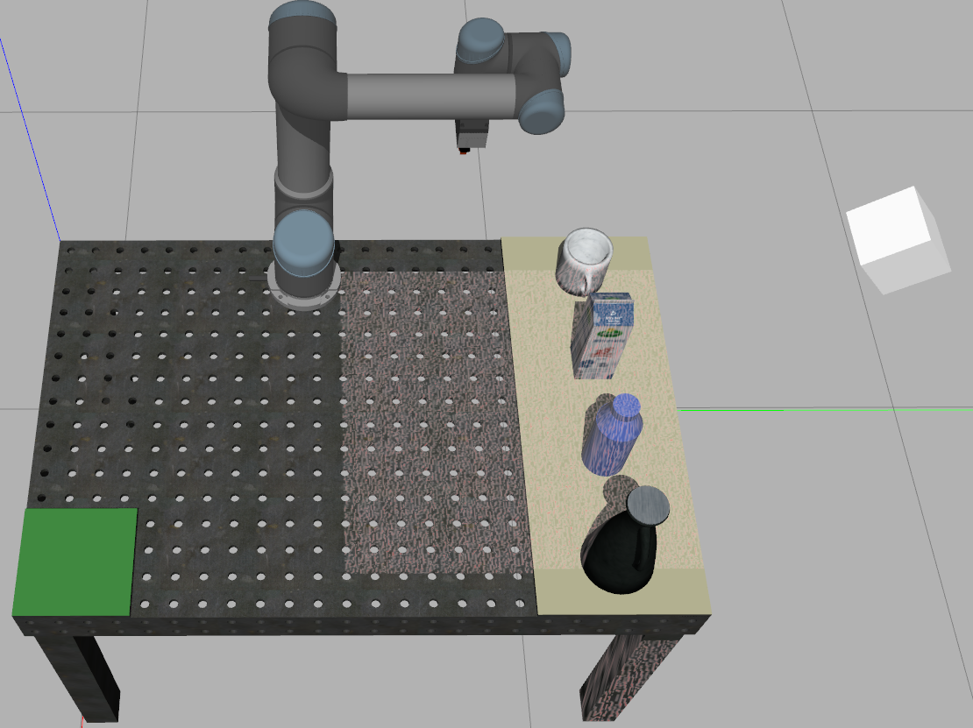

Slide 2
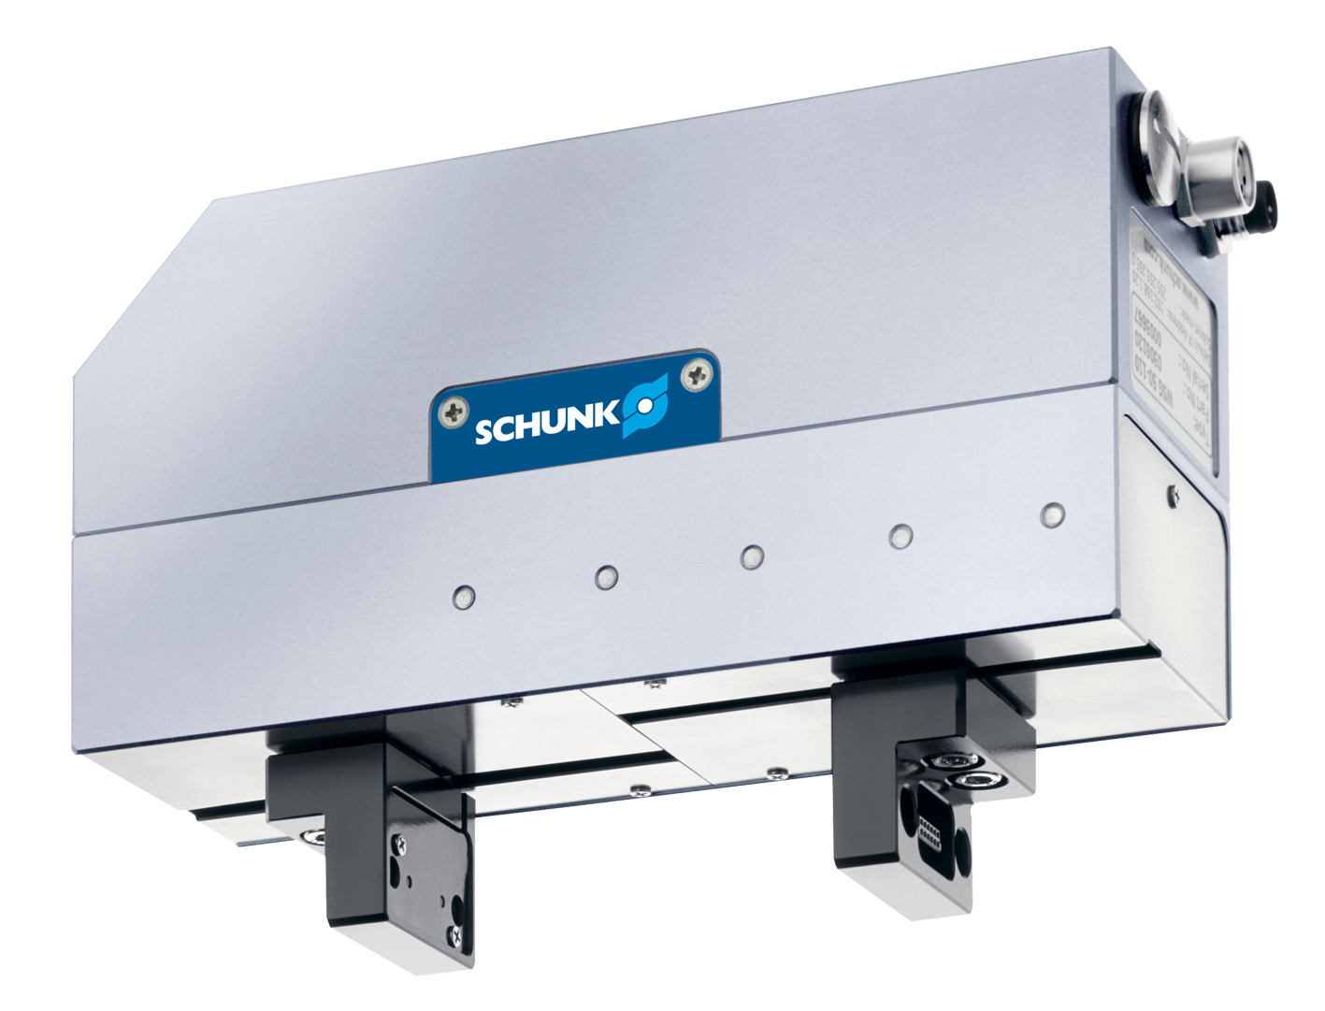

Slide 3
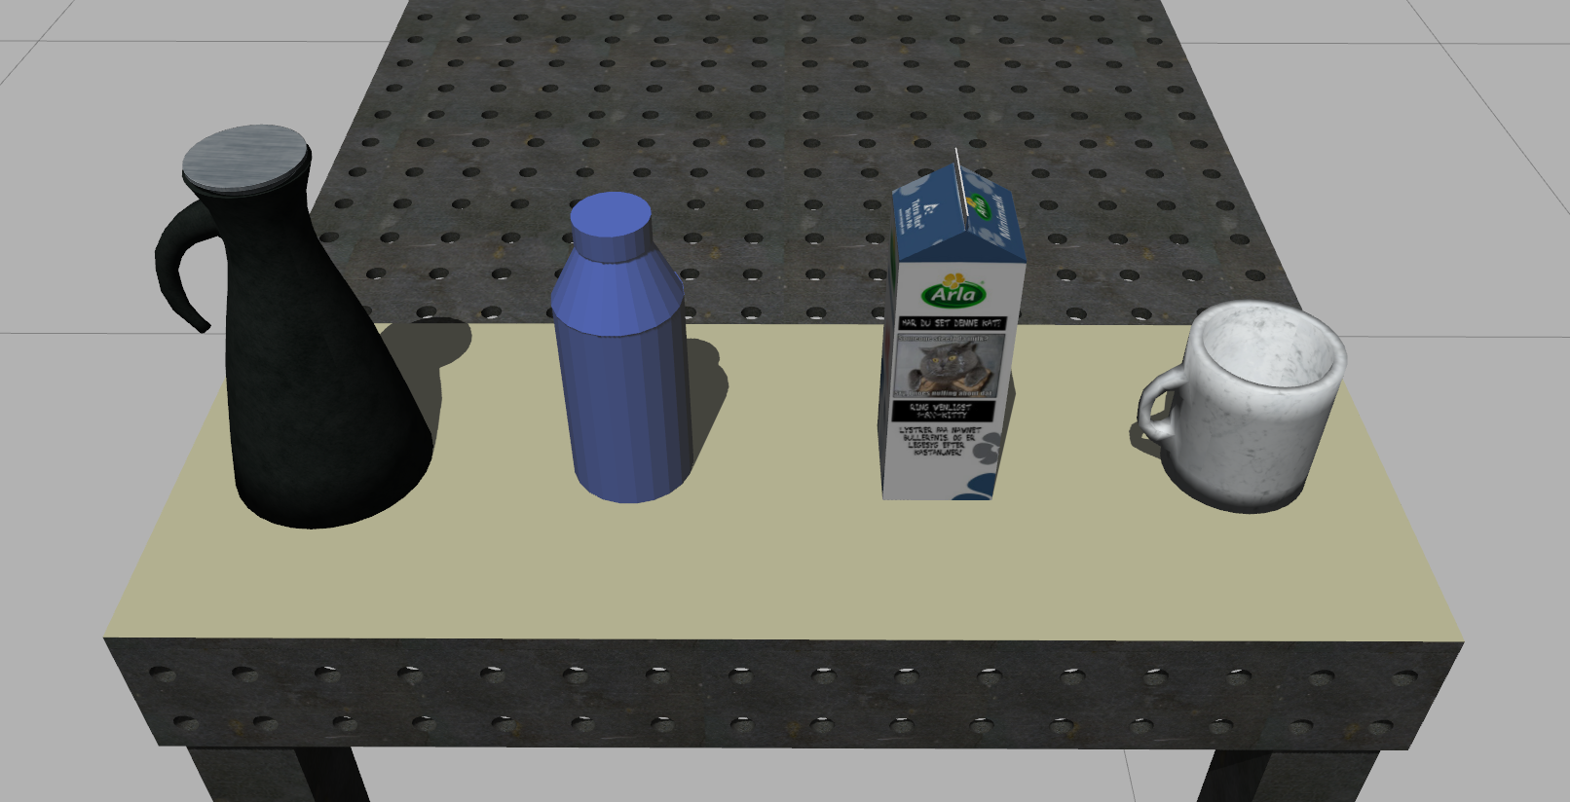

Slide 4
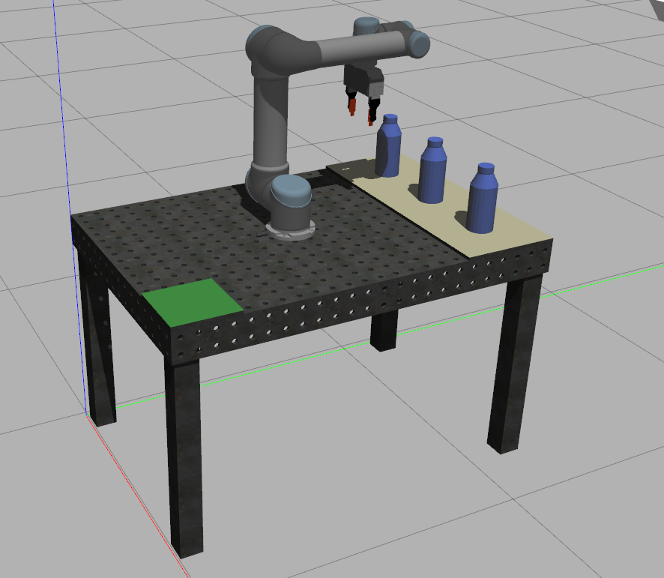

Slide 5
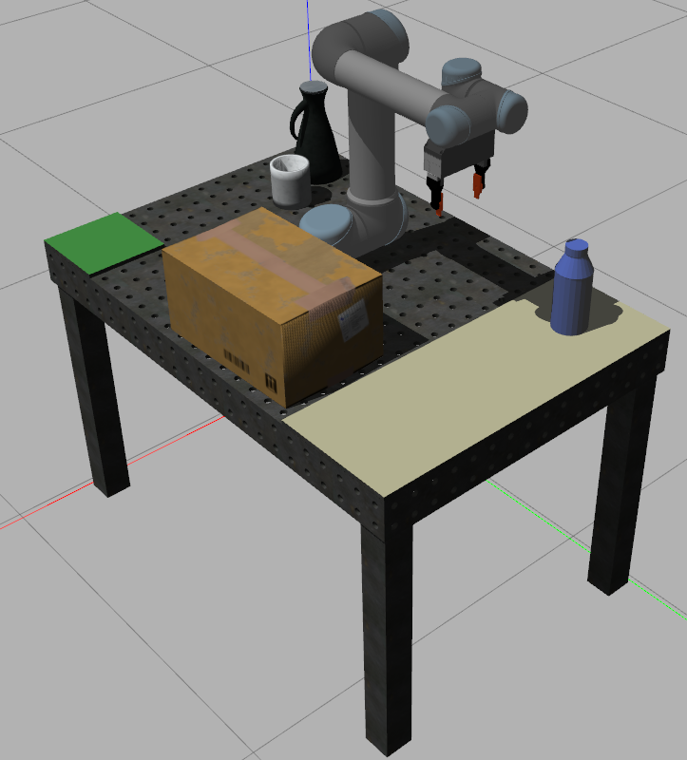

Slide 6
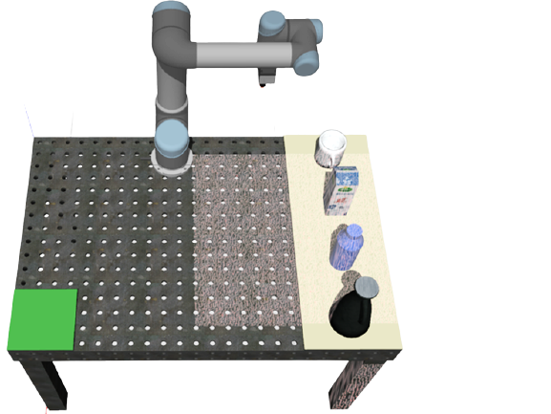

Pick area
Manipulator (UR5)
Sensors and Projector
Table
Place area
Graspable objects

Slide 7
Pick area
Manipulator (UR5)
Sensors and Projector
Table
Place area
Graspable objects

Slide 8
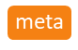
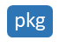
Package | Description
rovi_system | Packages related only to the ROVI project.
rovi_system | Integration of packages to provide a full pick and place pipeline.
rovi_models | Gazebo models and worlds for the the ROVI workcell.
rovi_planner | Interpolation-based trajectory generation.
rovi_vision | Computer vision-based pose estimation methods for objects in the ROVI workcell.
ur5_ros | Integration of UR5 manipulator into ROS/Gazebo/MoveIt ecosystem.
ur5_controllers | ROS Control controllers and interface for the UR5 robot.
ur5_description | URDF descriptions of the UR5 robot.
ur5_dynamics | Dynamics and kinematics of the UR5 robot.
ur5_gazebo | Gazebo interface for the UR5robot.
ur5_moveit_config | MoveIt! configuration for the UR5 robot.
ur5_planner | Motion planning and reachability analysis using MoveIt for the UR5 robot.
wsg50 | Model, controller, and interface for the WSG50 gripper.
ros_utils | Utilities for interfacing ROS/Gazebo/MoveIt/Eigen etc.

Slide 9
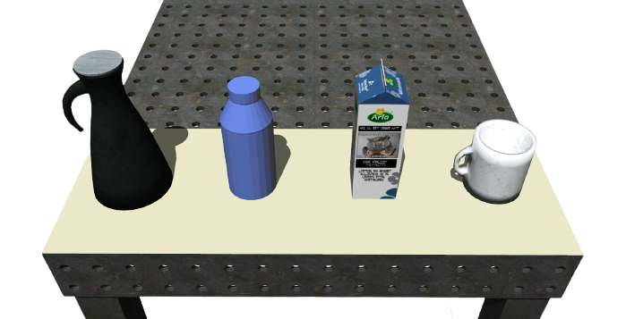

Slide 10
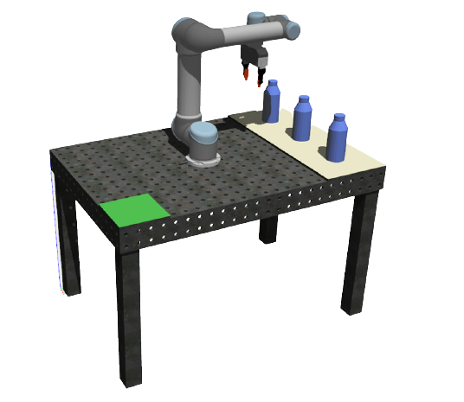

Slide 11


Slide 12
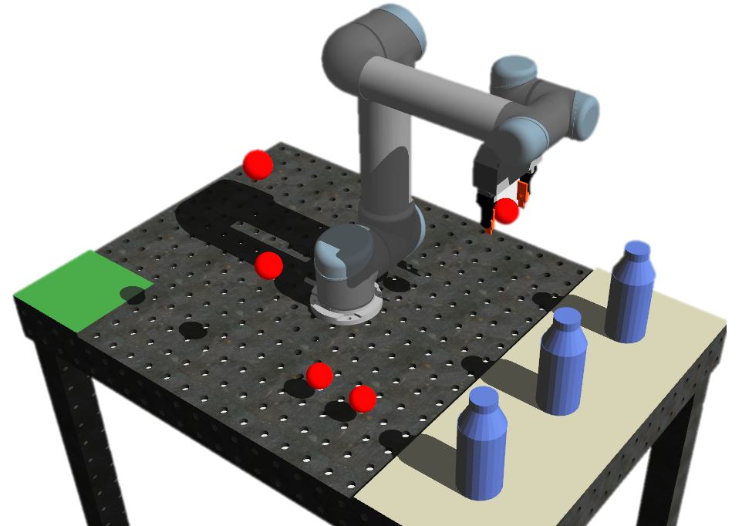
1
2
3

Slide 13
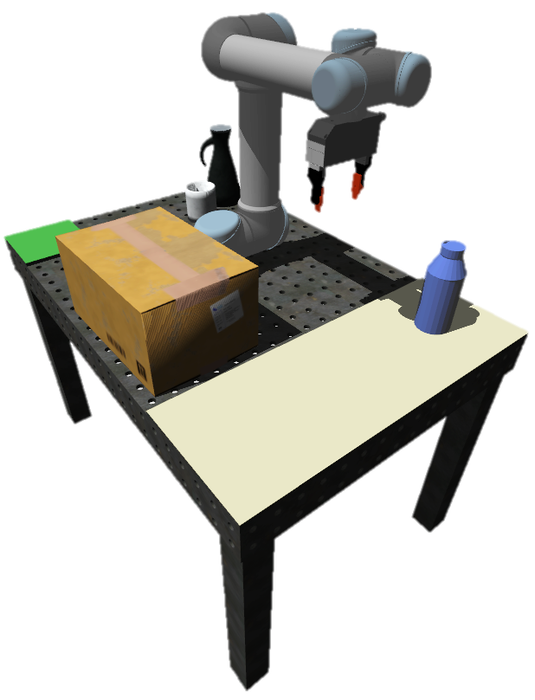

Slide 14
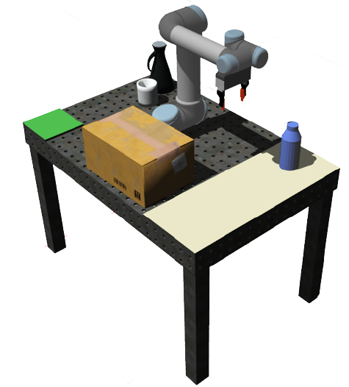

Slide 15
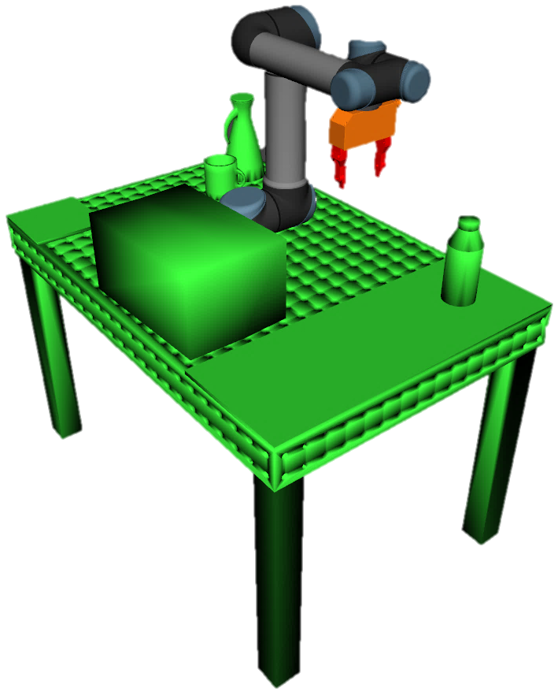

Slide 17
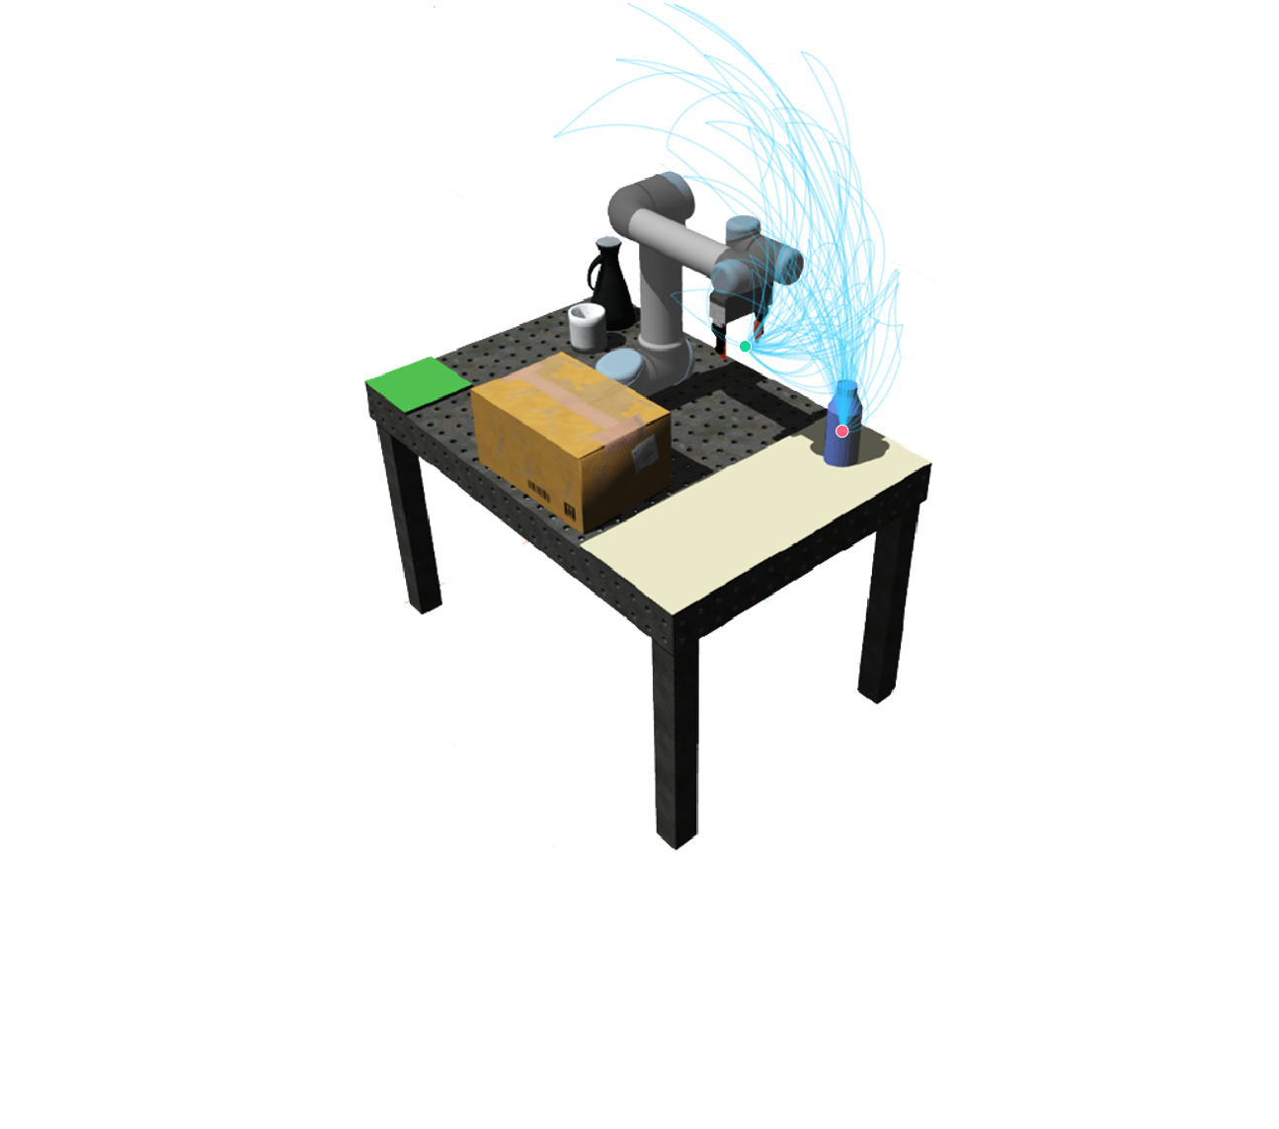
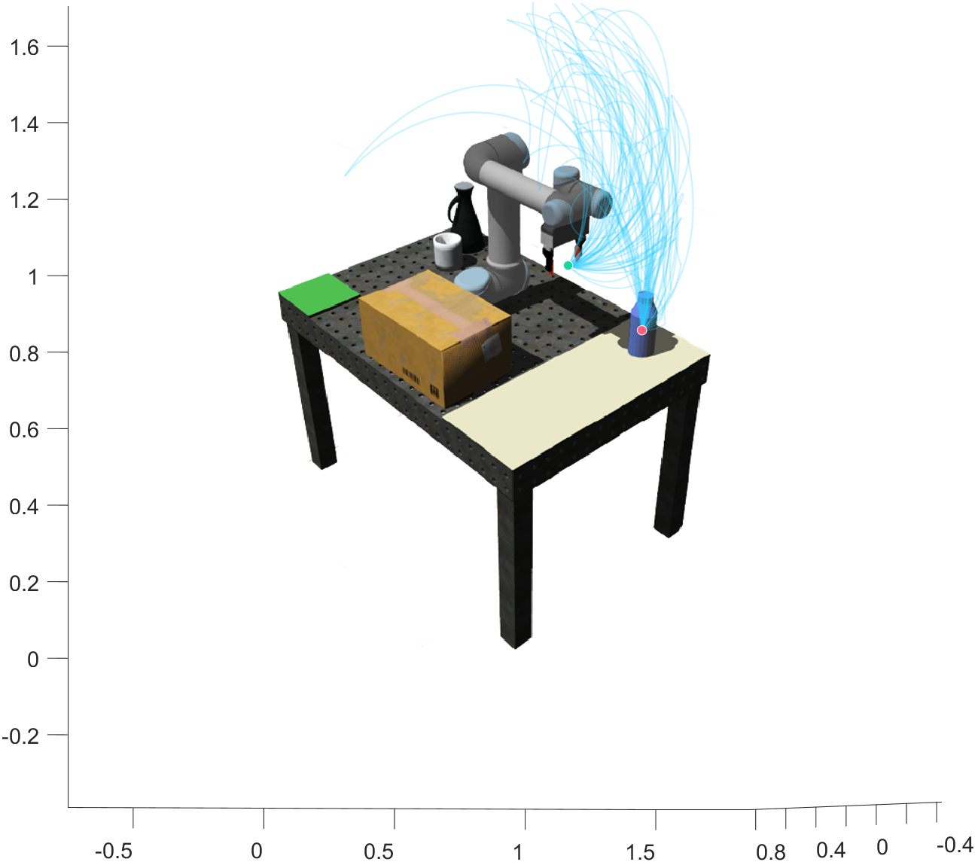

Slide 18
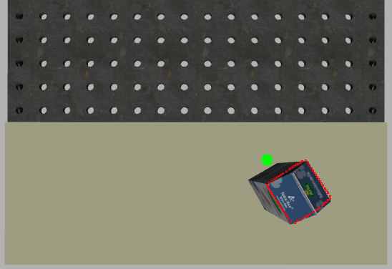
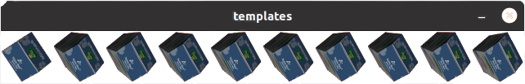
Best match
Ground truth

Slide 19
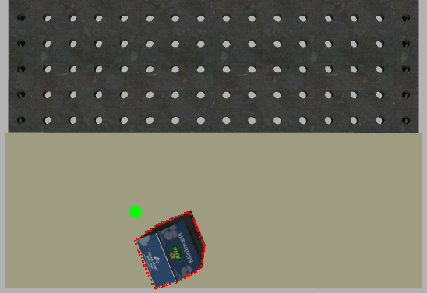
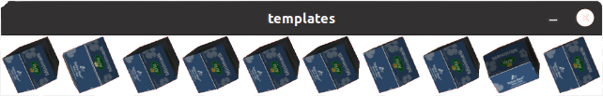
Best match
Ground truth

Slide 20
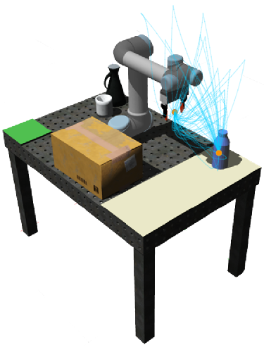

Slide 21
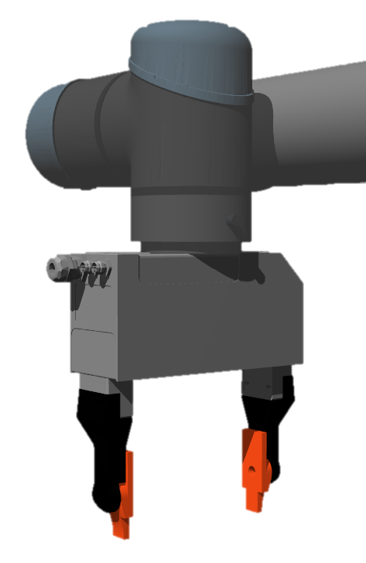
Flange (EE)
Gripper (TCP)

Slide 22
